Slide 1
WHO Guideline development
James Kiarie
Coordinator, Human Reproduction team,
Department of Reproductive Health and Research,
WHO

Slide 2
Notes:
Introduce WHO Guidelines
Describe the Process
Discuss how the evidence is handled
Discuss how recommendations made
Outline specific Guidelines for family planning

Slide 3
Introduction
The World Health Organization’s (WHO) primary mandate is to provide assistance to its Member States in achieving the goal of the highest attainable standard of health for all, including sexual and reproductive health.
Through
  Norms and guidelines
  Research
  Technical support

Slide 4
What is a WHO guideline ?
“A WHO guideline is any document, whatever its title, that contains WHO recommendations about health interventions, whether they be clinical, public health or policy interventions.”
”A recommendation provides information about what policy-makers, health-care providers or patients should do. It implies a choice between different interventions that have an impact on health and that have ramifications for the use of resources.”

Slide 5
Guideline development at WHO is a standard process

Slide 6
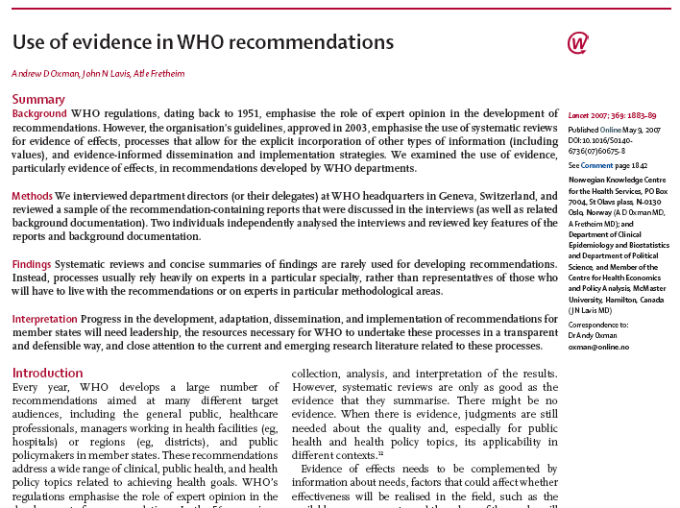
Why a Standardized Process
2007 Systematic review on Use of Evidence in WHO Guidelines
Summaries of findings rarely used
Rely heavily on specialty experts
No representatives of those who will have to live with the recommendations
No methodological experts

Slide 7
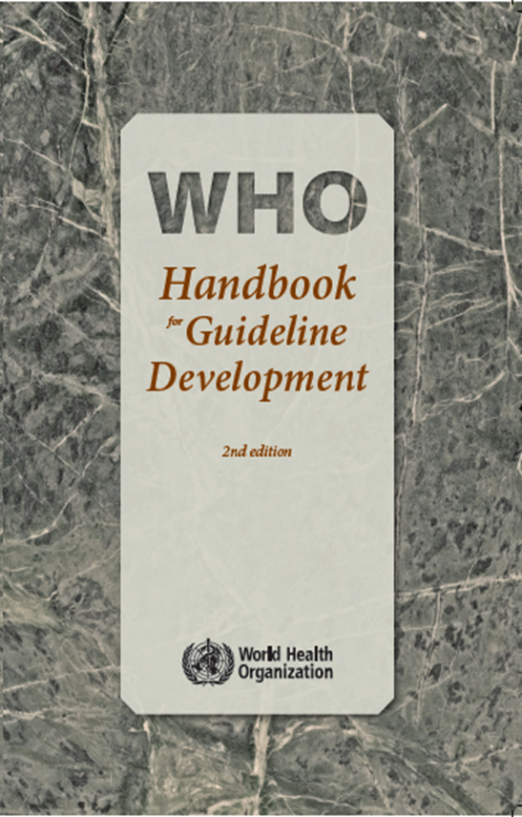
WHO Guidelines
Focus on end-users’ needs
Are based on highest-quality evidence
Incorporate multiple processes to minimize bias
All judgments and decision-making are transparent and explicit

Slide 8
The Guideline Development Process
WHO has internal regulations and standards for developing guidelines: WHO Handbook for guideline development
WHO Guidelines Review Committee (GRC) monitors the guideline development process and ensures that the relevant regulations and standards are applied
proposal content development
technical unit → GRC → technical unit→ GRC → final approval

Slide 9
The Guideline Development Process
In summary, the process includes:
  identification of priority questions and critical outcomes;
  retrieval of the evidence;
  assessment and synthesis of the evidence;
  formulation of recommendations;
  planning for dissemination, implementation, impact evaluation and updating.

Slide 10
Guideline development Process
CIRE
Continuous Identification and Review of Evidence
GSG
Guideline Steering Group
GDG
Guideline Development Group

Slide 11
Scoping
Set up WHO steering group
List the priority topics
Review by guideline development group
Search the literature for relevant data and existing systematic reviews
Review by guideline development group
Formulate draft PICO questions

Slide 12
GRADE: Grades of Recommendation Assessment, Development and Evaluation
Aim: to develop a common, transparent and sensible system for grading the quality of evidence and the strength of recommendations (over 100 systems)
International group of guideline developers, methodologists, and clinicians from around the world (>100 contributors) – since 2000
International group: ACCP, AHRQ, Australian NMRC, BMJ Clinical Evidence, CC, CDC, McMaster Uni., NICE, Oxford CEBM, SIGN, UpToDate, USPSTF, WHO

Slide 13
Determinants of Quality
RCTs start high
3 Factors raise the quality of the evidence
  Large magnitude of effect can upgrade one level
  Dose response relation
  Residual confounding unlikely to be responsible for observed effect
5 factors lower the quality of evidence
  Limitations of the studies, in design and execution
  Inconsistency
  Indirectness
  Imprecision
  Reporting bias
Observational studies start low
Notes:
13
13
13
Determinants: study design
RCTs start high
observational studies start low
5 factors lower

Slide 14
Quality of the evidence
The extent to which one can be confident that an estimate of effect or association is correct.
High, further research is very unlikely to change our confidence in the estimate of effect
Moderate, further research is likely to have an important impact on our confidence in the estimate and may change the estimate
Low, further research is very likely to have an important impact on our confidence in the estimate and is likely to change the estimate
Very low, any estimate of effect is very uncertain

Slide 15
WHO guidelines…
Must meet the highest quality standards for evidence-based guidelines
Must be based on high-quality systematic reviews of all relevant evidence
Use GRADE, which provides an explicit approach to:
  Assessing the quality of the evidence across studies and outcomes
  Translating evidence to recommendations
Incorporate multiple processes to minimize bias and optimize usability
Must incorporate transparency in all judgments and decision making

Slide 16
Formulation of recommendations
Strength of each recommendation will be determined by assessing each intervention based on:
  desirable and undesirable effects;
  quality of available evidence;
  values and preferences related to interventions in different settings;
  cost of options available to health-care workers in different settings;
  the perceived likelihood of the recommendation being modified as a result of further research.

Slide 17
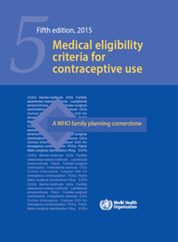


The Four Cornerstones of WHO’s FP evidence-based guidance
Medical Eligibility Criteria for Contraceptive Use
Selected Practice Recommendations for Contraceptive Use
Guidelines for policy-makers and programme managers
5th edition 2015
3rd edition in 2016
Tools for health-care providers
Decision-Making Tool for Family Planning Clients and Providers(to be updated)
Handbook for Family Planning Providers
2018
Notes:
WHO’s evidence-based guidance has four key “cornerstones”:
Name tall four here.
Draw attention to the following: MEC and SPR are designed to be used mainly by programme managers and policy makers, national/local experts. Their basic use in the country will be to help/guide develop national guidelines for FP. They are not designed to be used by health-care providers directly.
The DMT and the Handbook, on the other hand, are targeted directly towards health-care providers (i.e. user friendly, easy to read, illustrations etc.)

Slide 18

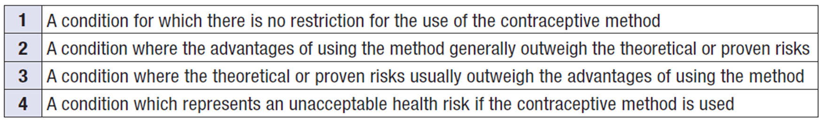
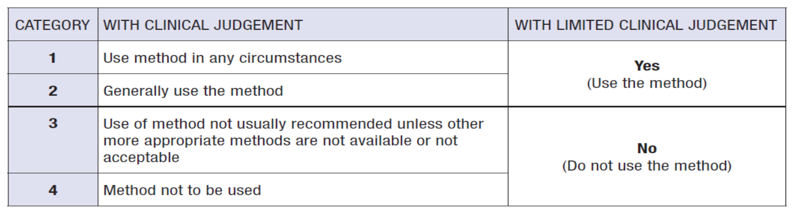
Unique situation with Family Planning
Recommendations based on Choice
Provides recommendations (> 2000) on eligibility for 25 methods of contraception

Slide 19

Thank you
For more information,
Follow us on Twitter @HRPresearch
Website who.int/reproductivehealth

